Slide 1
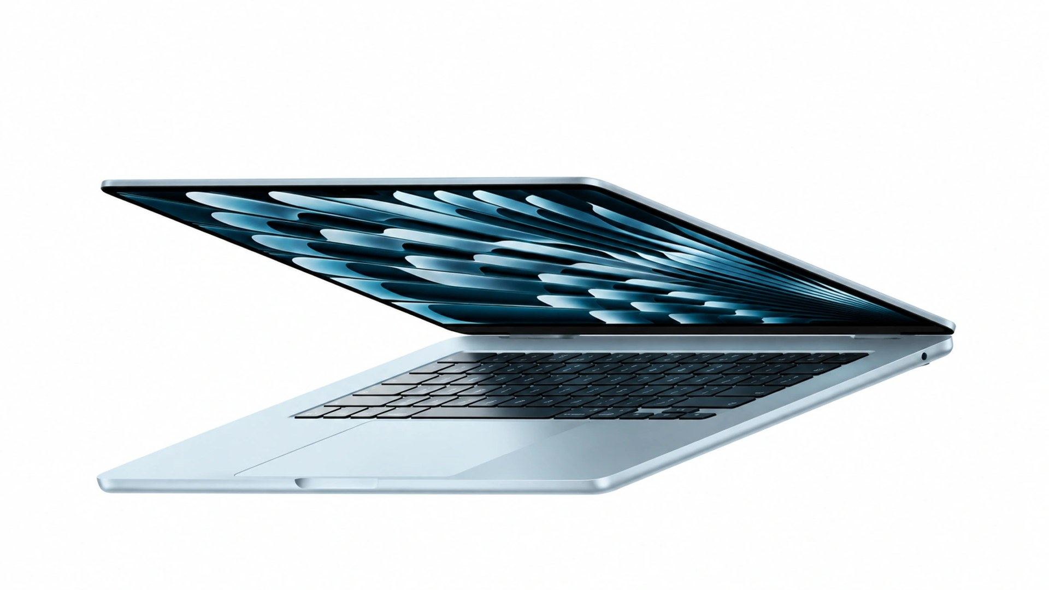

MacBook Air
Space for your ideas.
From the first sketch to the next presentation.
Independent concept · Palette · AI visual
01 / 03

Slide 2

Your ideas take shape.
01
The idea before the tool.
02
A benefit understood in one
sentence.
03
Space is part of the message.
Independent concept · Palette · AI visual
02 / 03

Slide 3

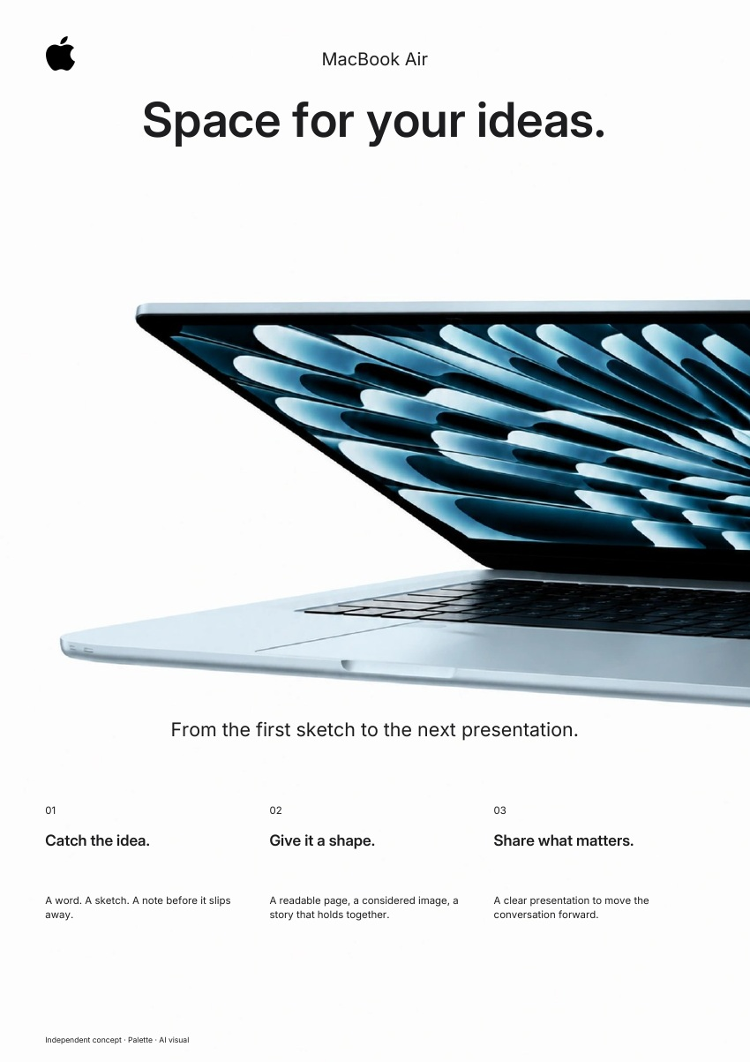
The same brand.
In every format.
A clear presentation to move the
conversation forward.
AD · 4:5
PDF · A4
Independent concept · Palette · AI visual
03 / 03

