Slide 1

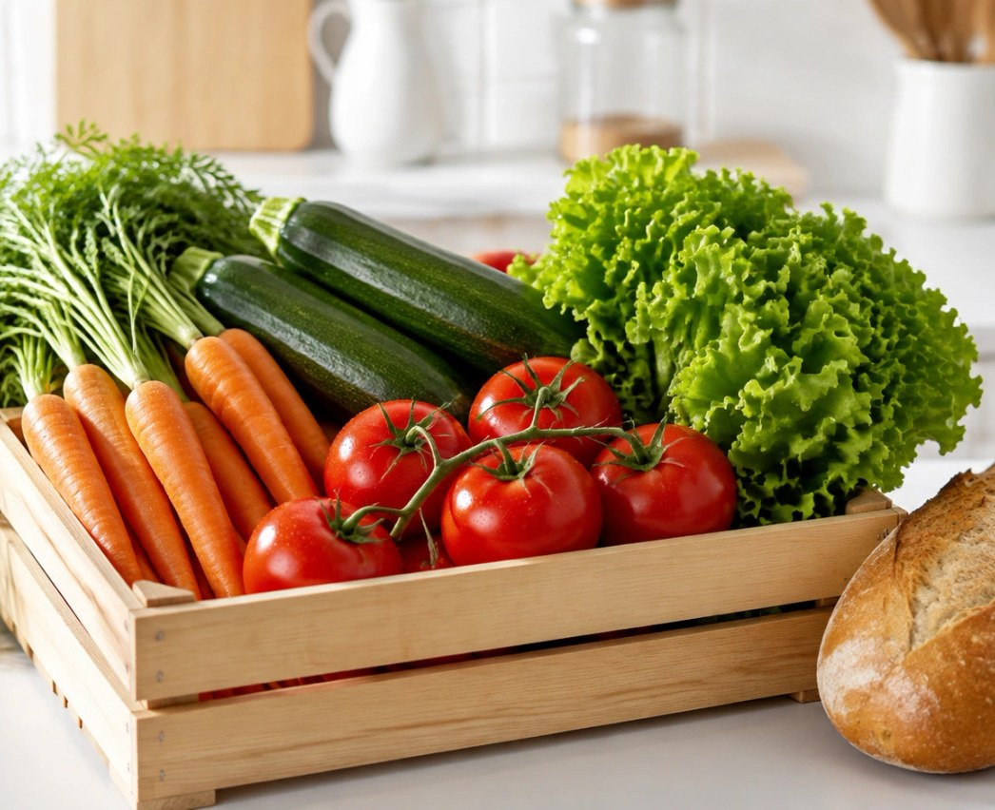
Everyday
tastes good.
Good ideas in the basket.
Independent concept · Palette · AI visual
01 / 03

Slide 2
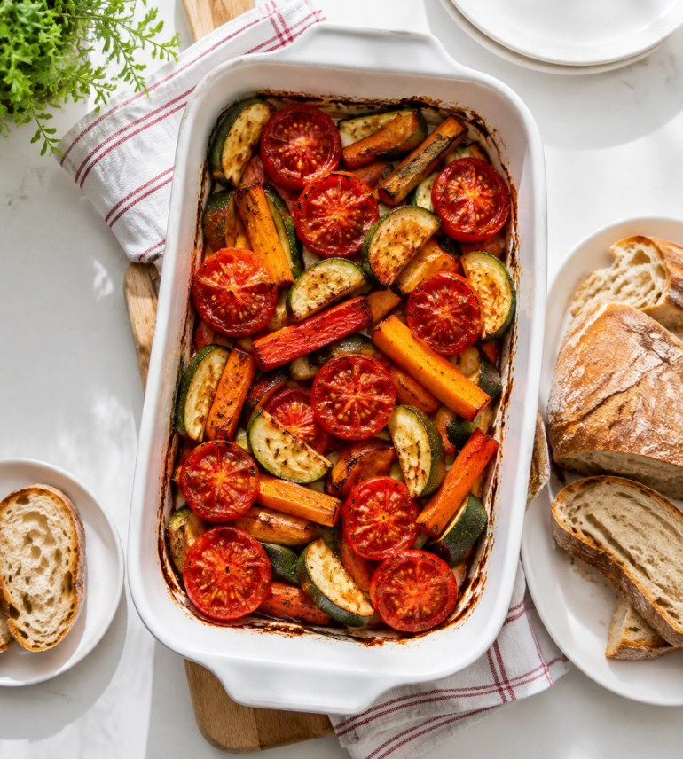
01
Groceries becoming a meal.
02
A simple idea to use tonight.
03
Recognizable produce, not an
abstract promise.
Independent concept · Palette · AI visual
02 / 03

Slide 3
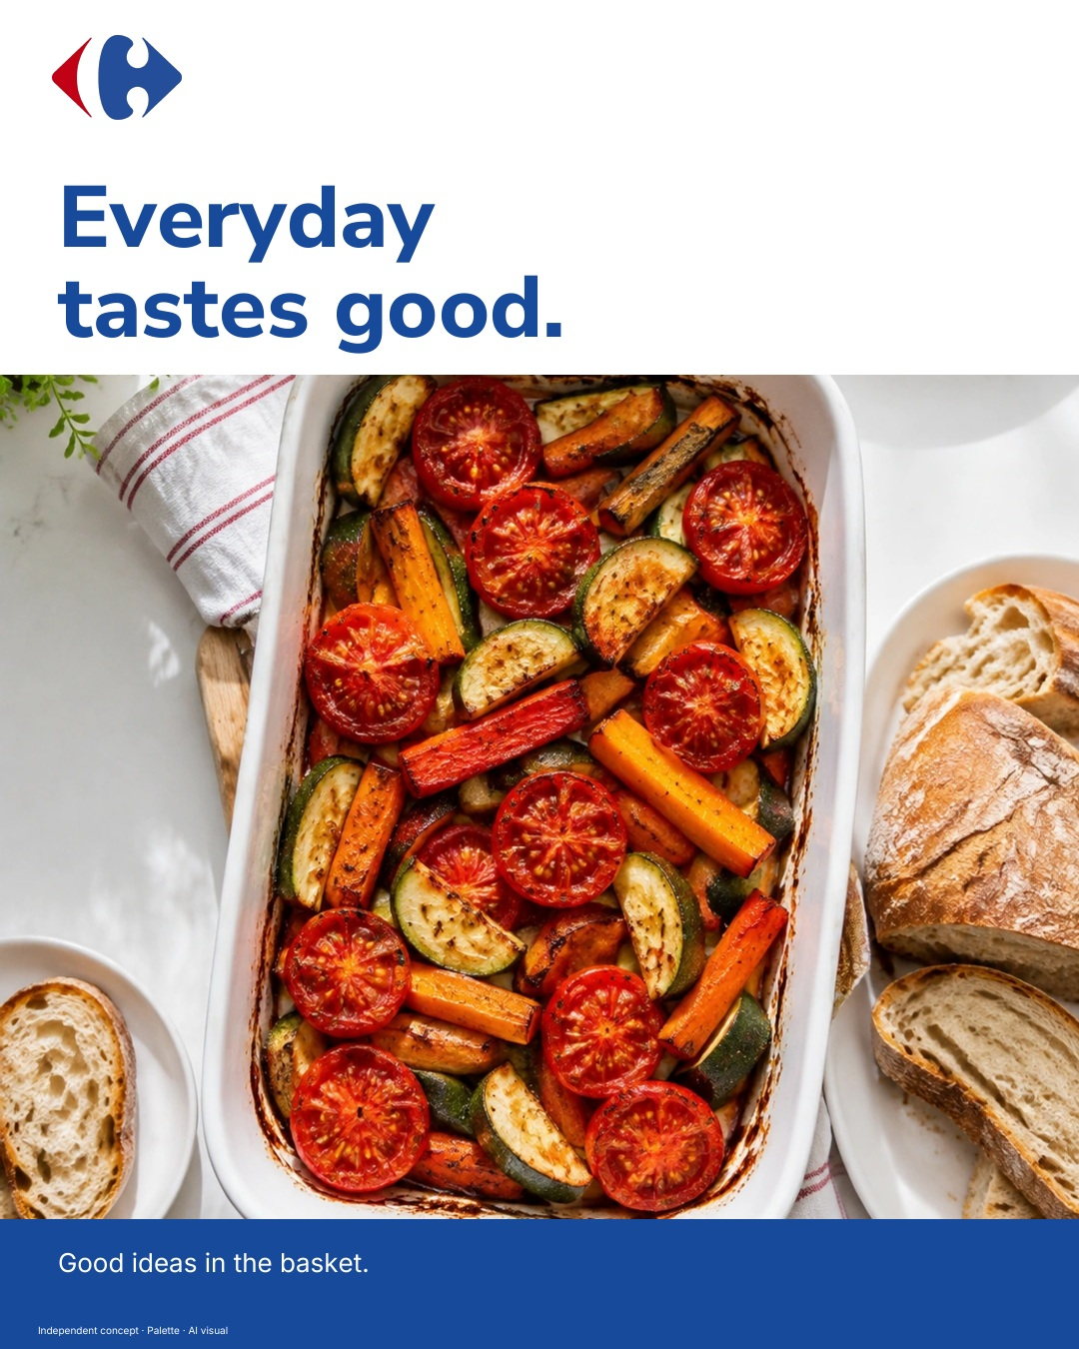
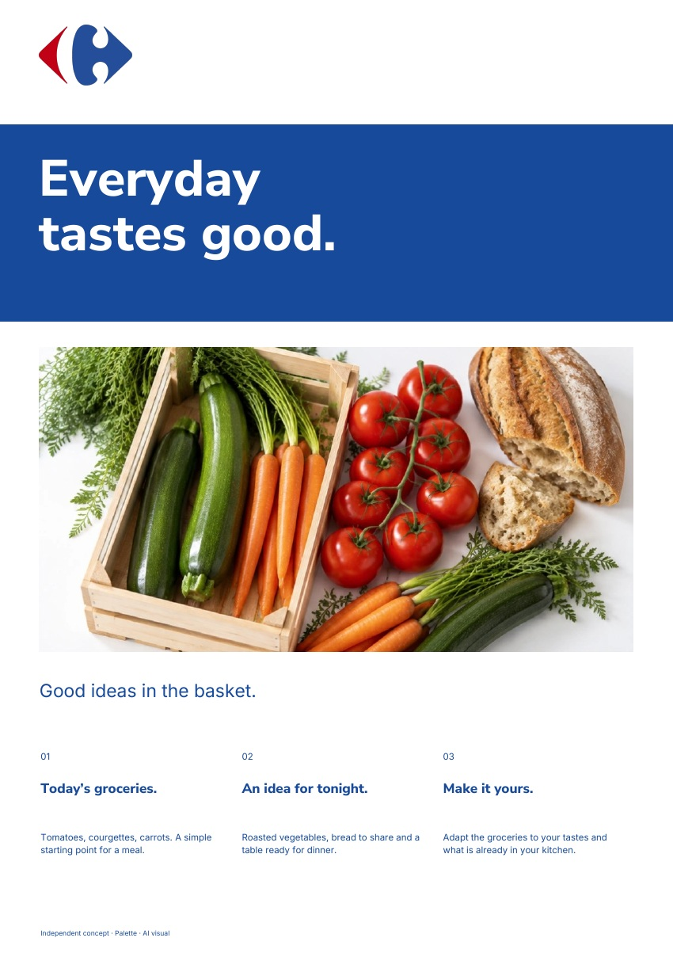
The same brand.
In every format.
Adapt the groceries to your tastes and what
is already in your kitchen.
AD · 4:5
PDF · A4
Independent concept · Palette · AI visual
03 / 03

