Slide 1
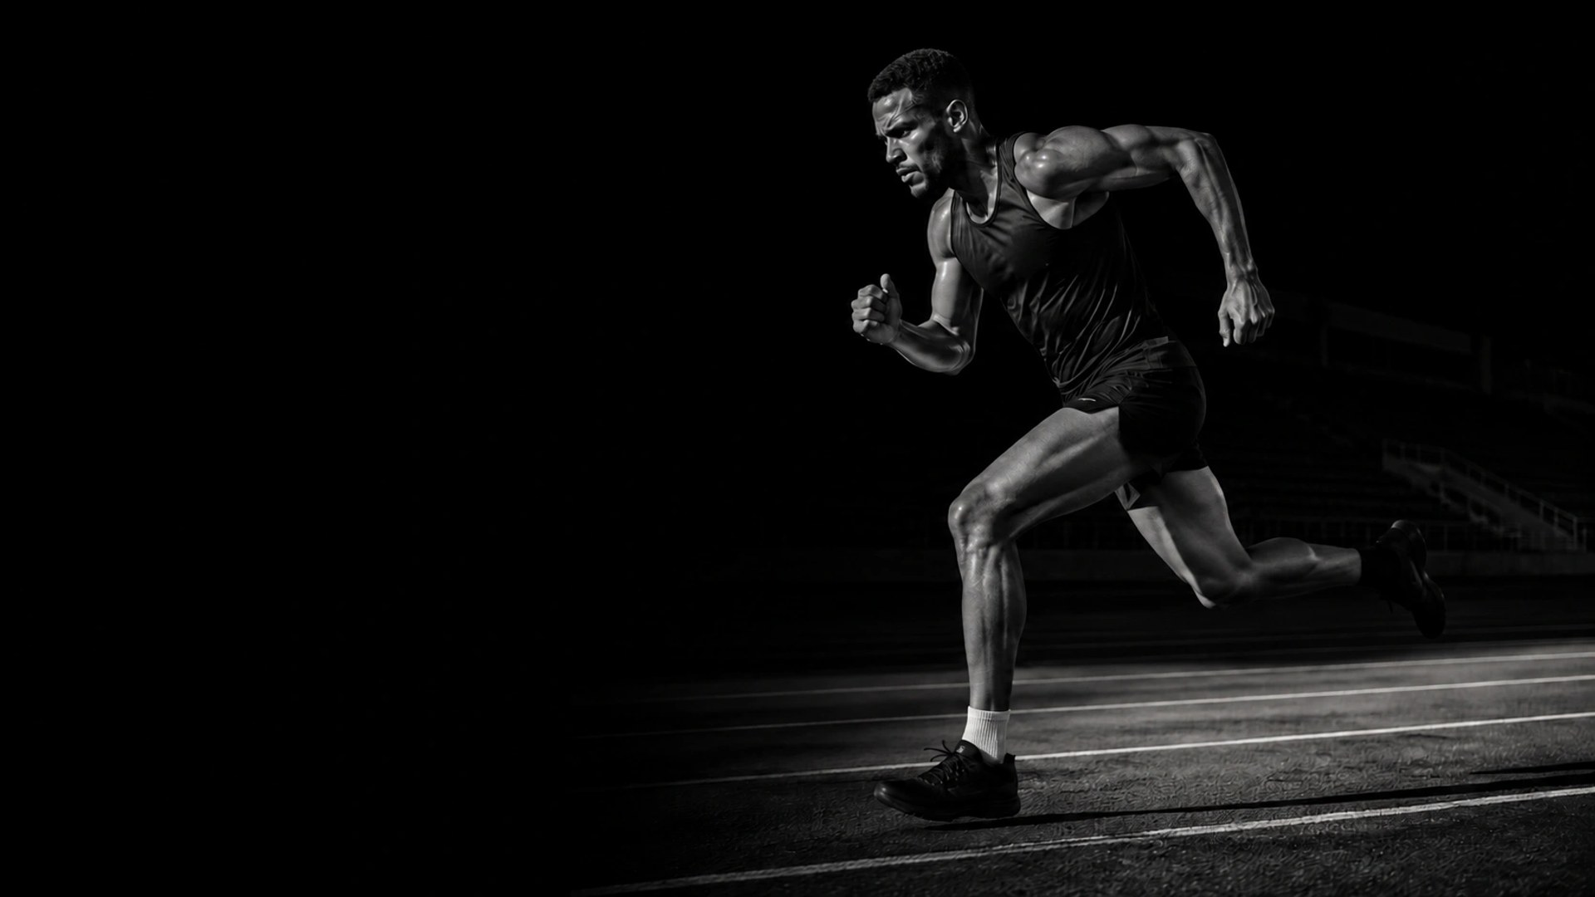

THE
NEXT
STEP.
Your pace. Your start.
Independent concept · Palette · AI visual
01 / 03

Slide 2
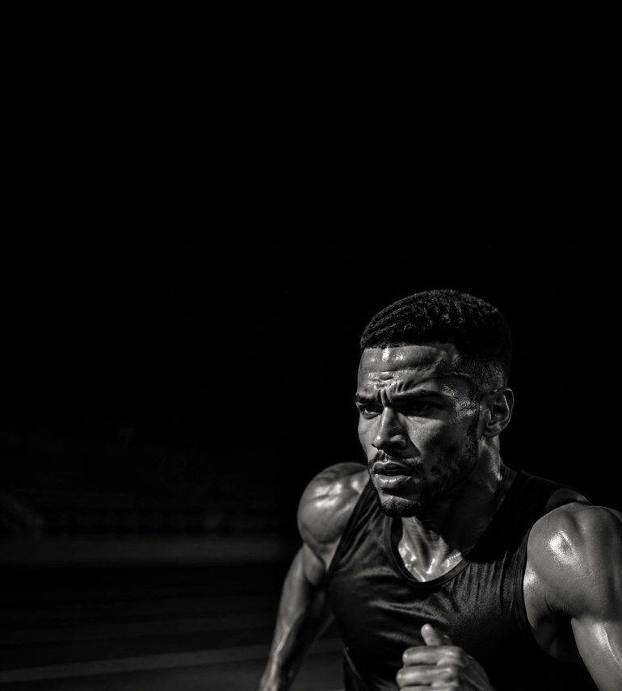
01
MOVEMENT BEFORE RESULTS.
02
A START AT YOUR OWN PACE.
03
ONE MOVEMENT, ONE IMAGE, ONE
INVITATION.
Independent concept · Palette · AI visual
02 / 03

Slide 3
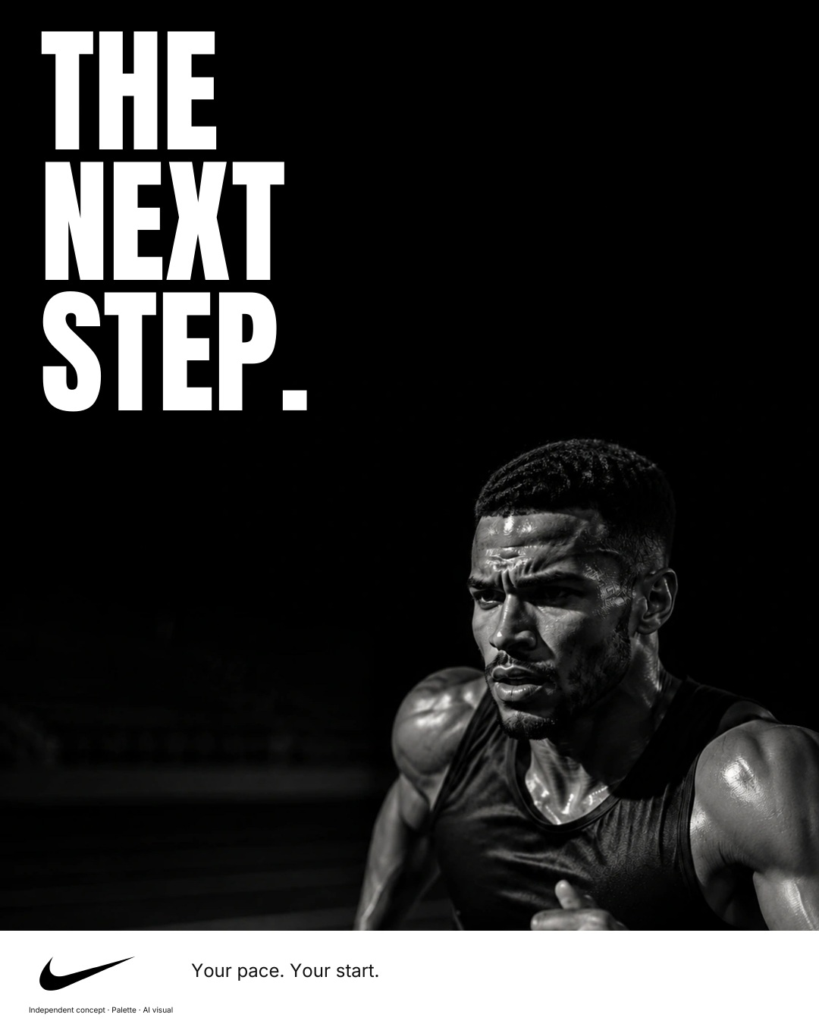
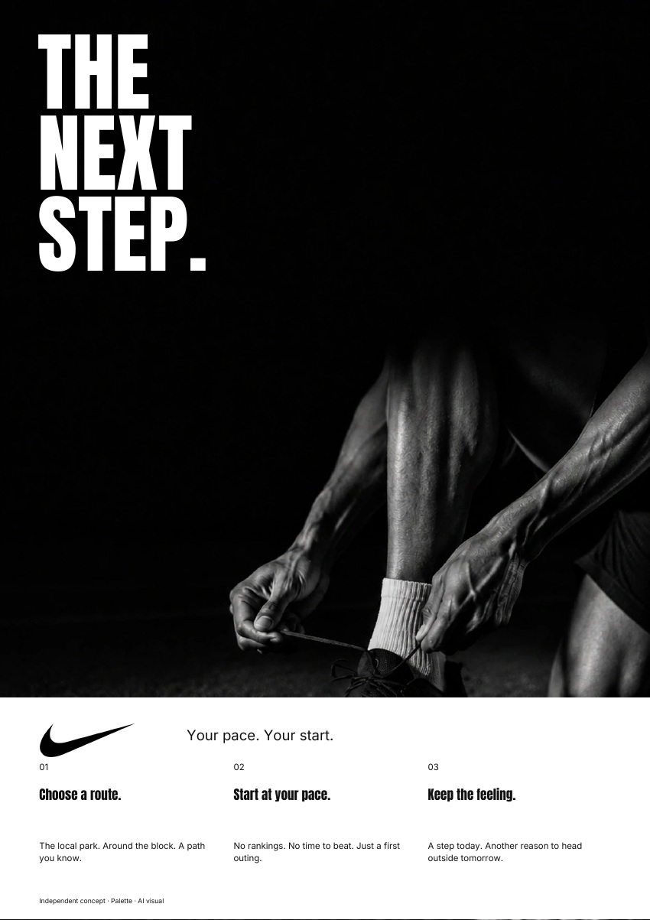
THE SAME BRAND.
IN EVERY FORMAT.
A step today. Another reason to head outside
tomorrow.
AD · 4:5
PDF · A4
Independent concept · Palette · AI visual
03 / 03

