Slide 1
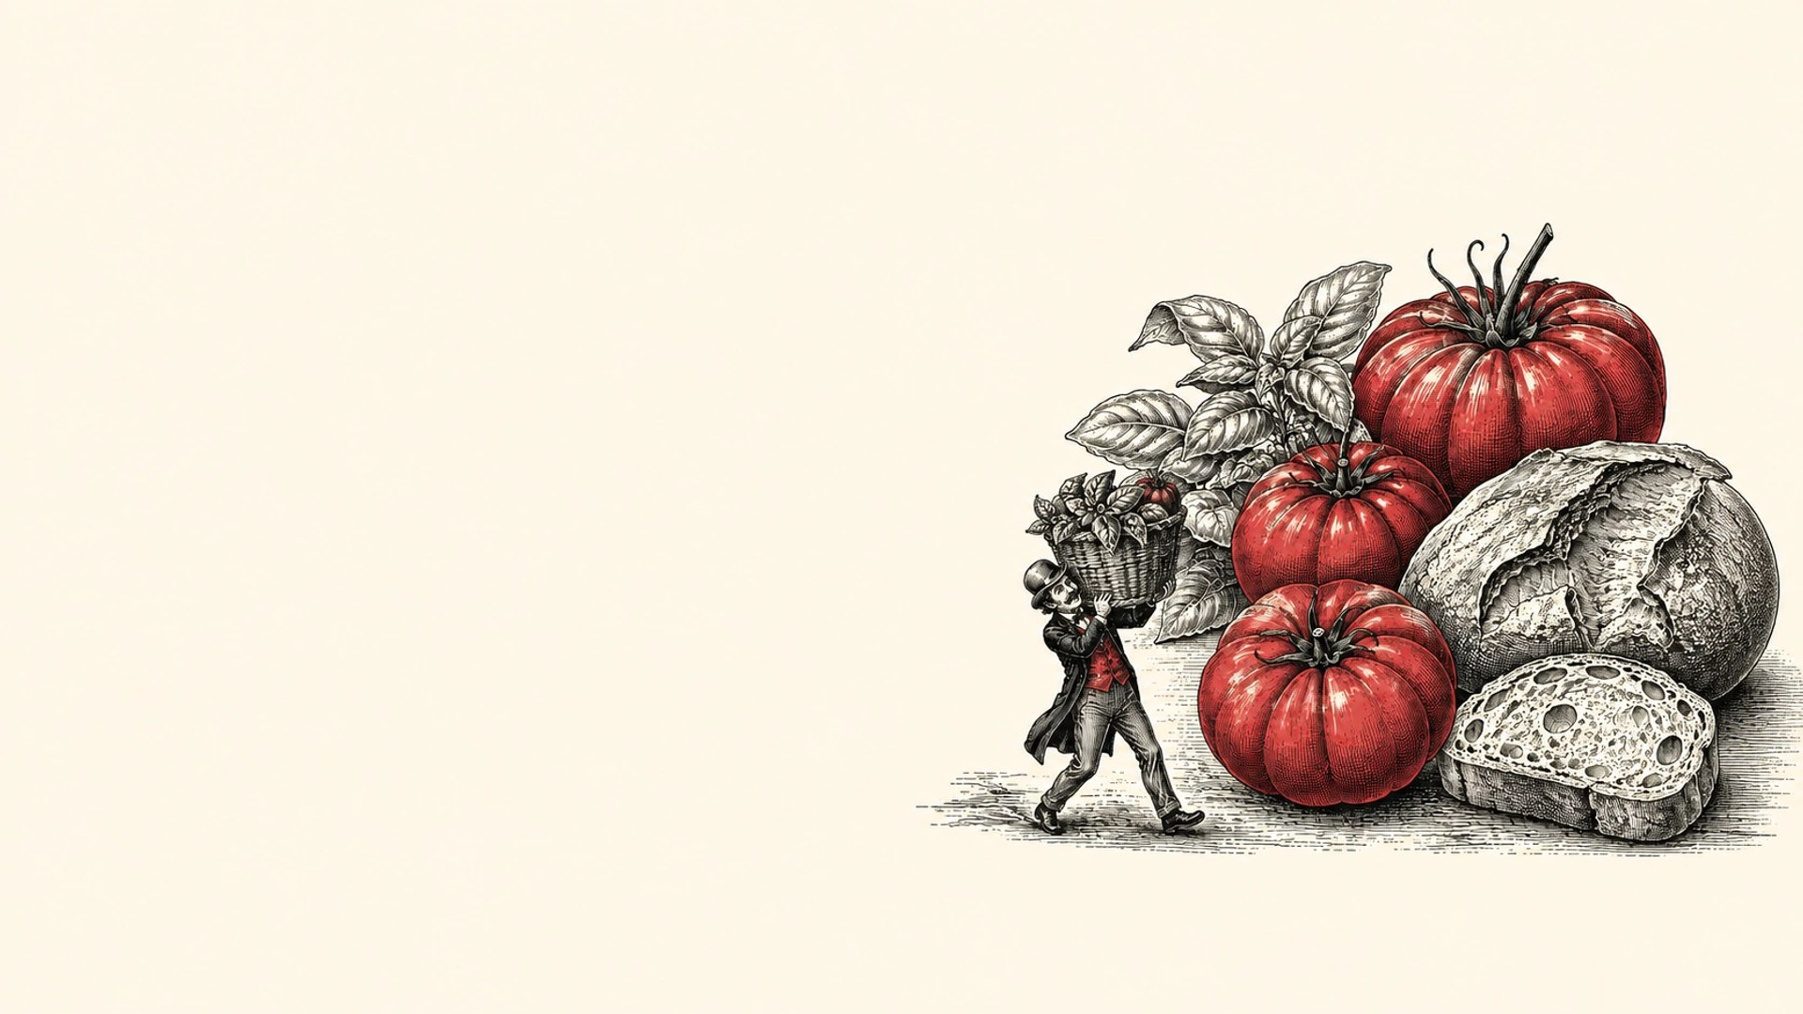

Made for
sharing.
Tomatoes. Basil. Good company.
Independent concept · Palette · AI visual
01 / 03

Slide 2
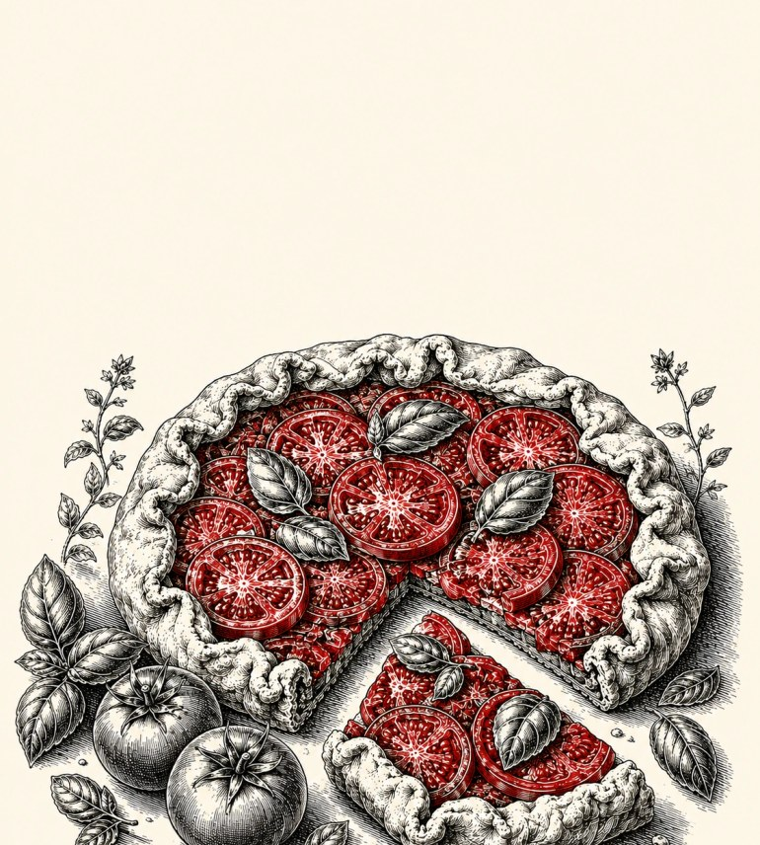
01
A discovery that makes you
hungry.
02
Recognizable ingredients.
03
The joy of making room for
one more.
Independent concept · Palette · AI visual
02 / 03

Slide 3
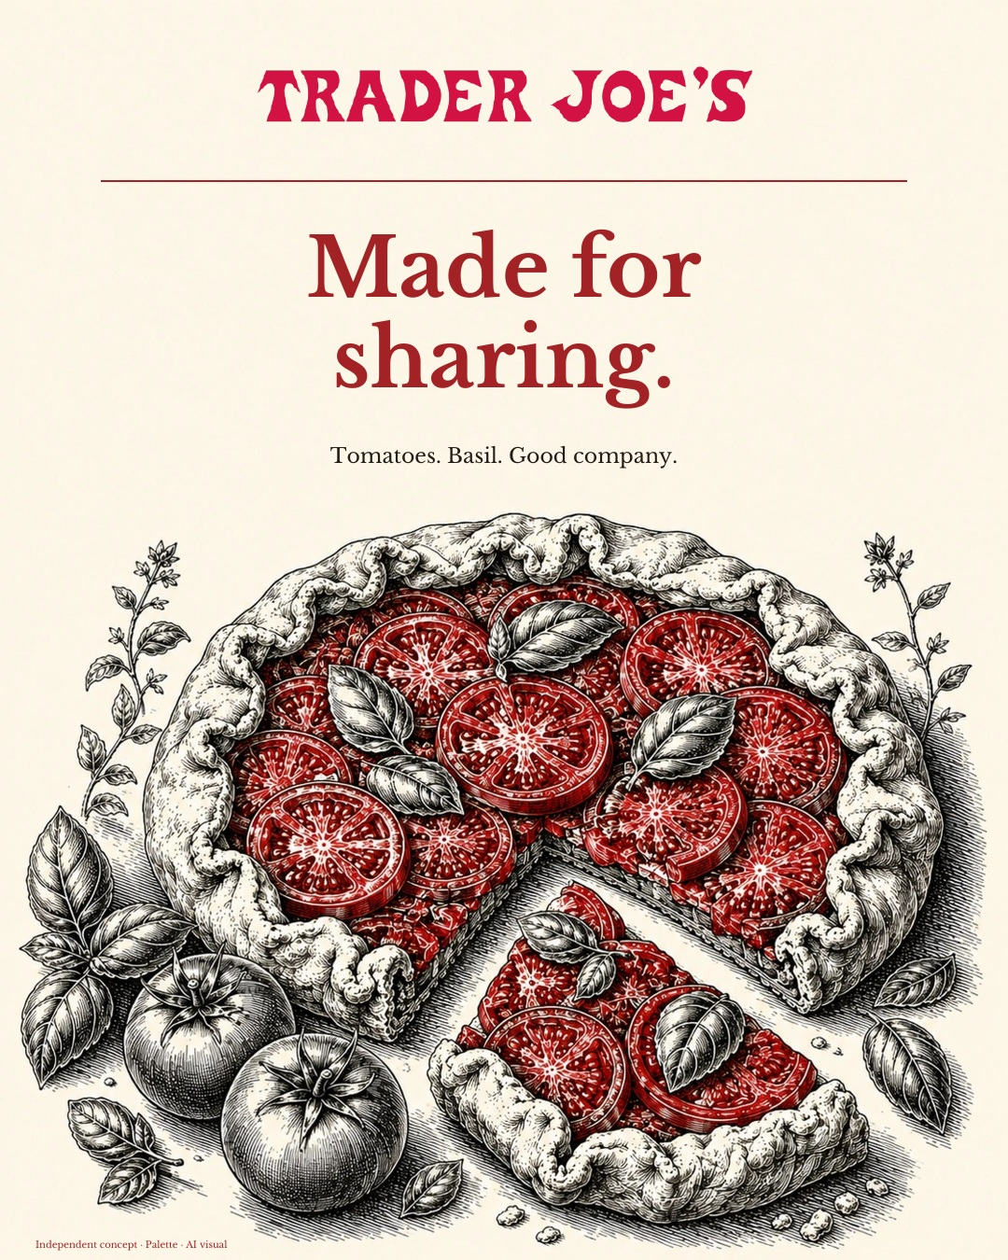
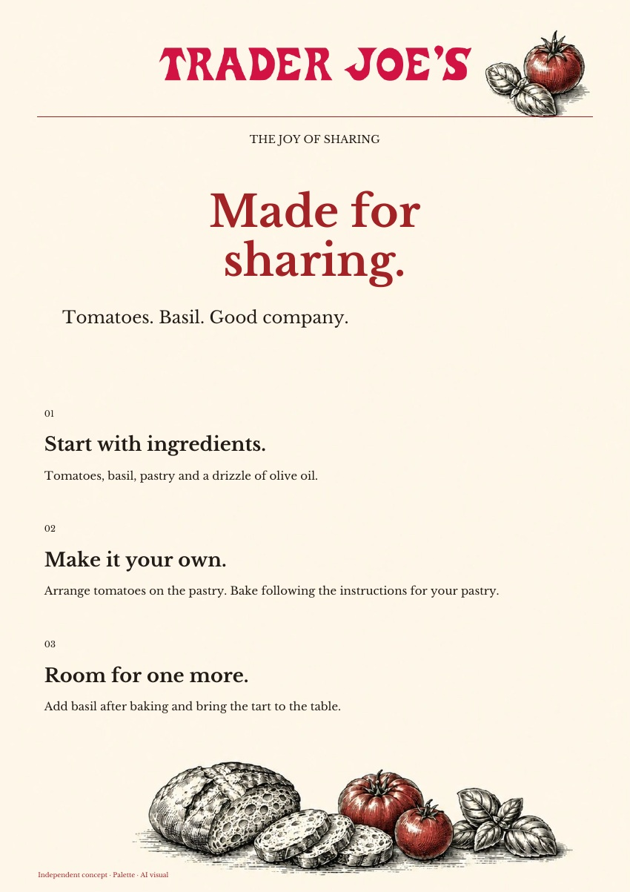
The same brand.
In every format.
Add basil after baking and bring the tart
to the table.
AD · 4:5
PDF · A4
Independent concept · Palette · AI visual
03 / 03

