Slide 1

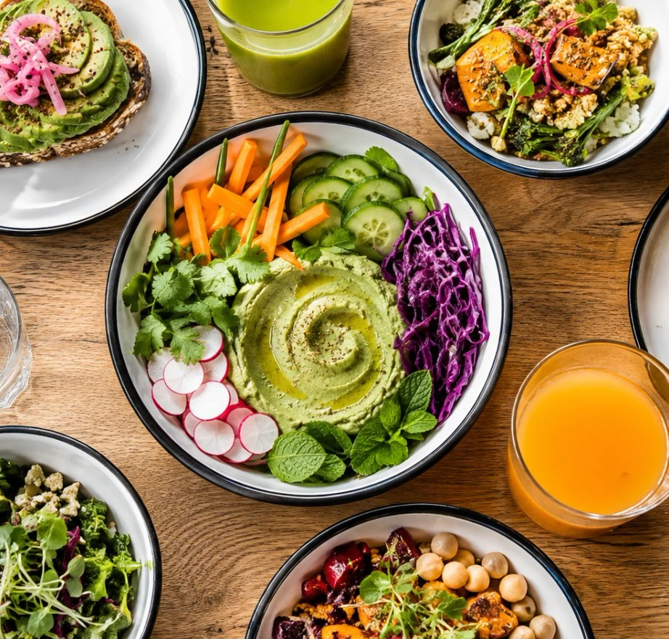
TAKE A BREAK.
GO PLANT-BASED.
Some crunch. Some color. A moment for
you.
Independent concept · Palette · AI visual
01 / 03

Slide 2
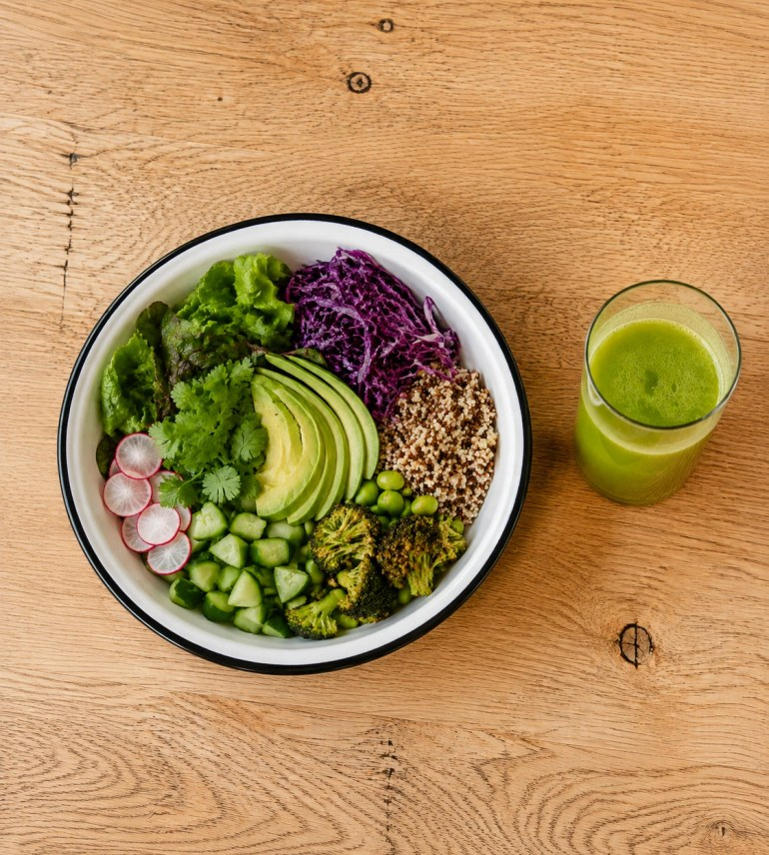
01
Plant-based, through ingredients.
02
A pause in the city’s rhythm.
03
Enjoyment without a lecture.
Independent concept · Palette · AI visual
02 / 03

Slide 3
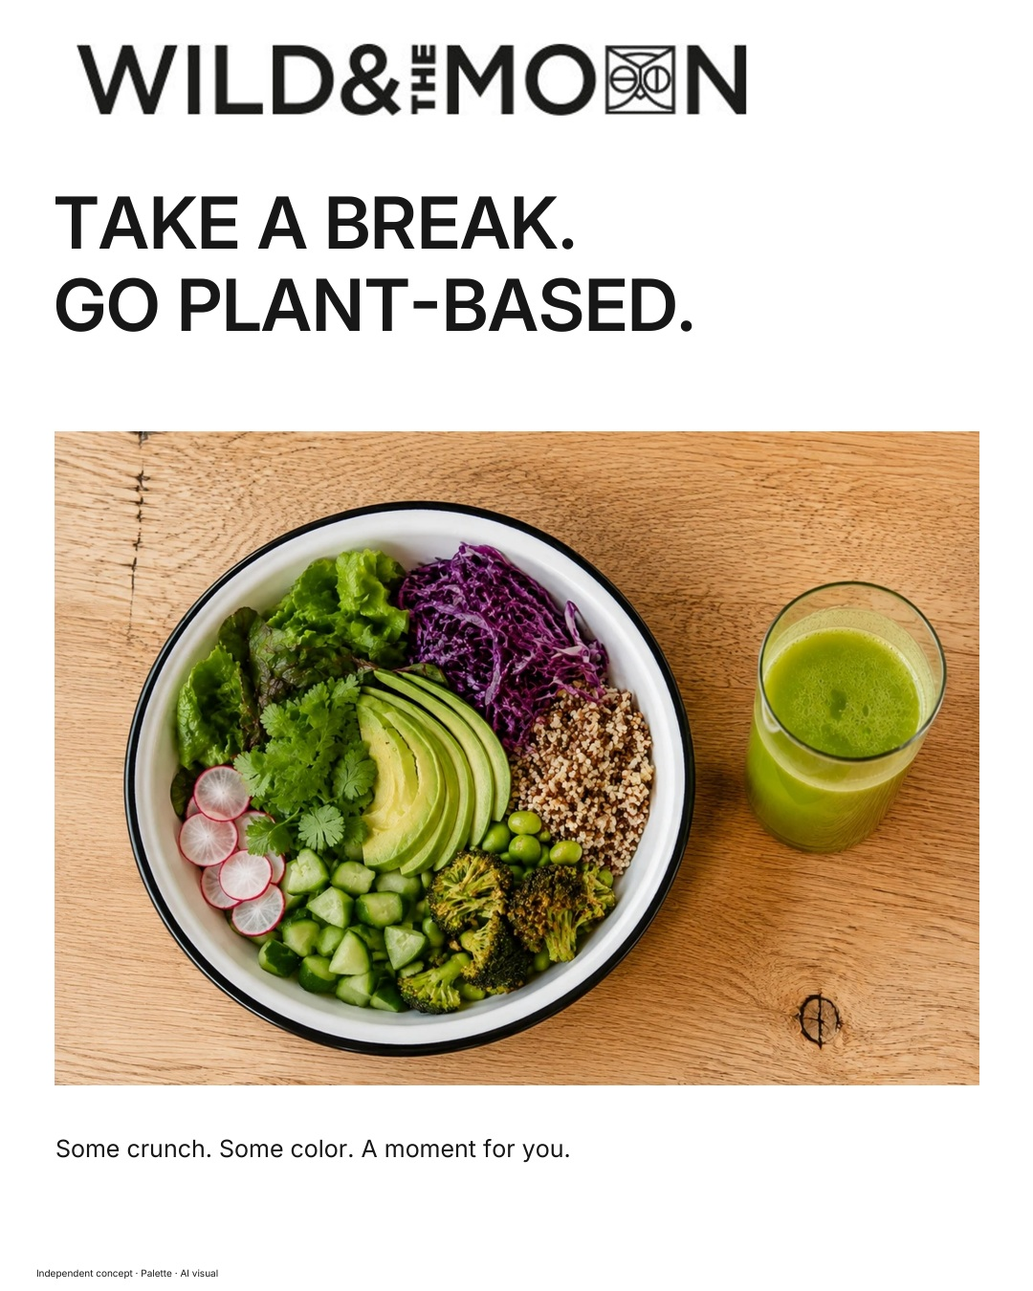
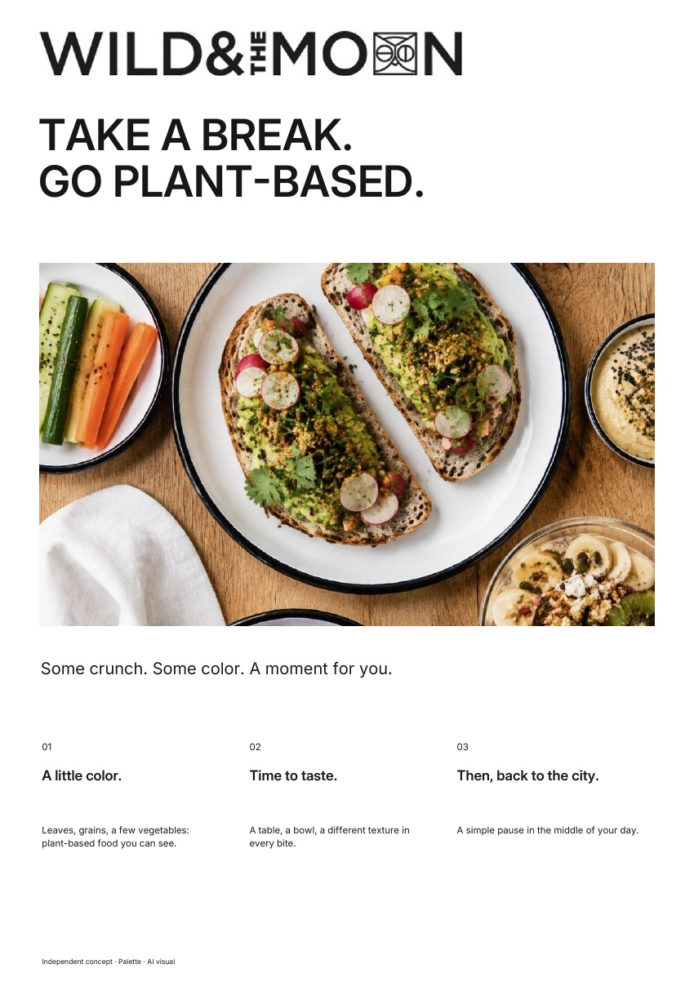
The same brand.
In every format.
A simple pause in the middle of your day.
AD · 4:5
PDF · A4
Independent concept · Palette · AI visual
03 / 03

